Slide 1
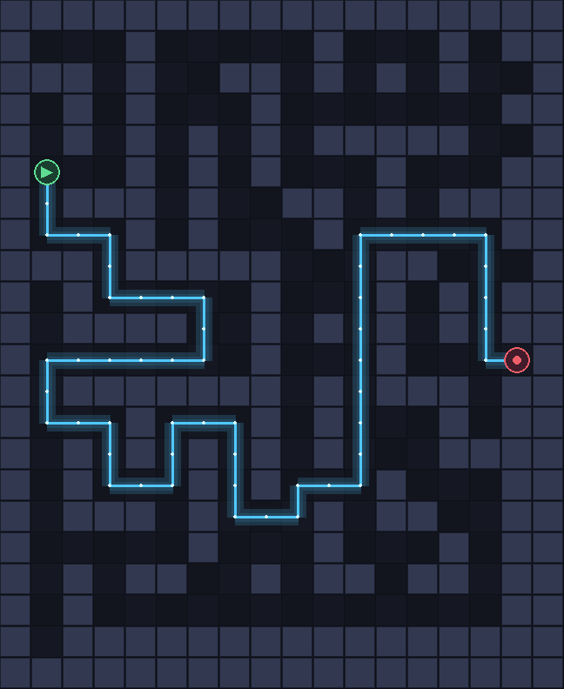
SEMESTER 5 · ARTIFICIAL INTELLIGENCE
AI TOWER
DEFENSE
Maze generation. A* search.
Live re-planning.
Randomized DFS
A* Search
Live Re-pathing
TEAM
[Member 1] · [Member 2] · [Member 3]
Roll numbers: [add your roll numbers here]
Review 1 · Rust + Bevy · algorithms first
Notes:
Title slide. Introduce the team and frame the project as three algorithms: randomized DFS, A* search and live re-planning. Replace the member placeholders before submitting.

Slide 2
01 · PROBLEM
02 / 08
The map is a graph that keeps changing
Enemies need a route through a grid. The player blocks cells by building towers, so the graph changes during play.
WHY IT IS AN AI PROJECT
Generation Randomized DFS + wall braiding.
The project is built around three algorithms: generate a solvable maze, search it with A*, and re-plan whenever the graph changes.
Search A* with a Manhattan distance estimate.
Adaptation Re-path after every accepted graph change.
Safety Validate a build before it is committed.
GENERATE
SEARCH
VALIDATE
Randomized DFS carves a connected maze; braiding adds loops.
A* finds the lowest-cost route from every gate to the core.
A build is rejected if it makes any gate unreachable.
The player changes the problem; the algorithms solve it again.
FOCUS · Generation, heuristic search and graph validation — the game is only the testbed.
Notes:
The game is only the testbed. The real problem is a graph that changes while it is being solved: the player blocks cells, and the AI must keep the maze solvable.

Slide 3
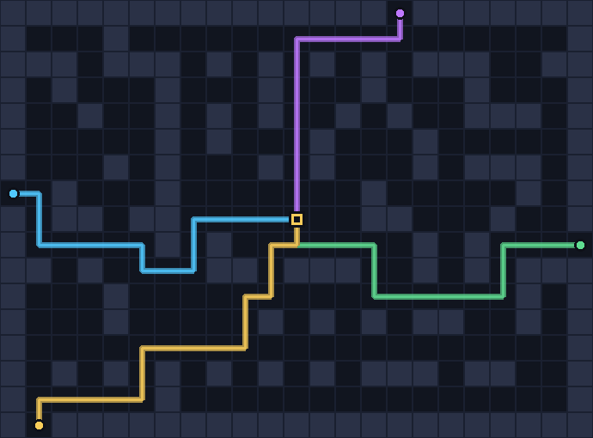
02 · ALGORITHM 1 · GENERATION
03 / 08
Randomized DFS builds the maze
01
Carve with a stack
A recursive backtracker visits every lattice cell once, carving to a random unvisited neighbour and backtracking at dead ends. Linear time in the number of tiles.
02
Braid the walls
32% of the remaining interior walls are removed, turning dead ends into loops. Loops give the player choices and stop one tower from sealing the whole map.
03
Anchor the core and gates
A central chamber is carved for the core and four edge gates are opened. A* verifies every gate reaches the core before the level goes live.
Four gate-to-core routes · 23 × 17 tiles · gold = core
23 × 17 grid
32% braided
4 gates connected
Complexity: O(W · H) · a seed reproduces any maze.
Notes:
Maze generation is a randomized depth-first search. It carves every cell once, then braiding removes 32 percent of the remaining walls. Four edge gates and a central core are added, and A* verifies connectivity.

Slide 4
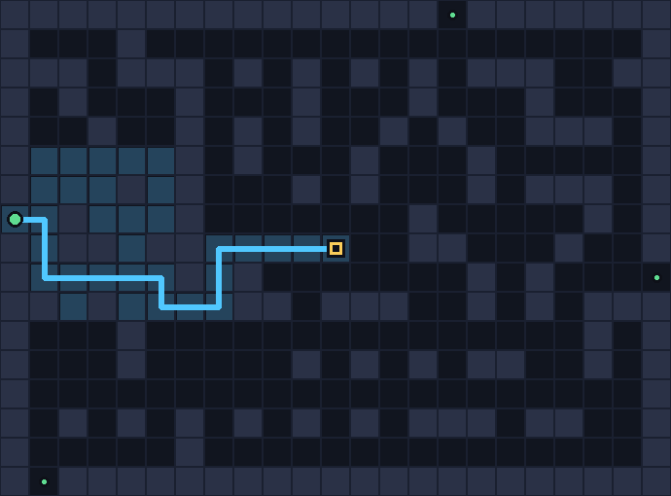
03 · ALGORITHM 2 · SEARCH
04 / 08
A* finds the shortest route
f(n) = g(n) + h(n)
g: cost from the gate · h: Manhattan estimate to the core
Priority frontier
A min-heap expands the lowest f-score first; a closed set avoids repeats.
Admissible heuristic
Manhattan distance never overestimates on this grid, so A* returns an optimal route rather than just a valid one.
Live graph
Explored nodes in blue · route in cyan
A tower is a blocked cell. Builds are validated from all gates, and accepted builds re-path every enemy.
Wall
Explored
Route
Optimality matters: the route length is the cost the player is trying to increase.
O(E log V) per search
4-connected paths
Notes:
A* uses f = g + h. The heuristic is Manhattan distance, which is admissible on a 4-connected grid. The frontier is a binary heap, so the lowest f-score expands first and the result is optimal. Because the graph is live, builds are validated from all gates and accepted builds re-path every enemy.

Slide 5
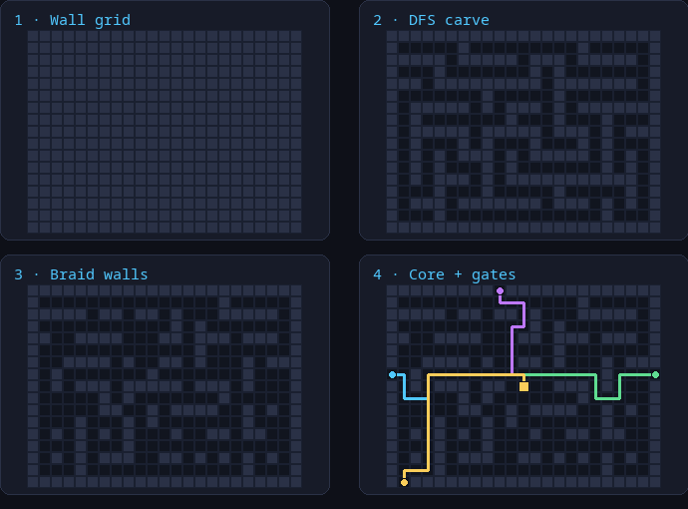
04 · MAP GENERATION · PIPELINE
05 / 08
From empty grid to playable maze
01
Start with walls
The grid begins fully blocked; only the odd lattice cells are candidates for carving.
02
DFS carve
A randomized backtracker visits every cell once, carving corridors and backtracking at dead ends.
03
Braid 32%
Remove leftover interior walls to create loops, so one tower cannot seal the only route.
04
Core + four gates
Carve a 3×3 core chamber, open edge gates, then A* checks every gate-to-core route.
Pipeline: wall grid → DFS carve → braid → core + gates
23 × 17 grid
32% braid
O(W · H)
A seed reproduces the same maze; generation is linear in tiles.
Notes:
This is the full generation pipeline. Start with a wall grid, carve with randomized DFS, braid 32 percent of the walls into loops, then add the core and four gates. The design choices matter: one route is too easy to block, loops create choices, and four gates create multiple fronts.

Slide 6
05 · TECHNOLOGY · WHY RUST
06 / 08
Why the project moved to Rust
No GC pauses
PYTHON → RUST
A* runs for every enemy and after every accepted build; Rust keeps frame times predictable.
Prototype Python was fast to write but slow with many enemies.
Rewrite Rust gives predictable performance and one binary.
Compile-time safety
Ownership and Result make graph edits and validation failures explicit.
Cost Steeper learning curve and longer compile times.
Simulation vs Bevy
The game rules are a pure Rust module; Bevy only renders the state.
WHY IT MATTERS
Algorithms A* and validation stay fast under load.
Cargo tooling
Tests headless simulation; no window needed.
Build, test, clippy and fmt are one command each; 64 tests run headlessly.
Ship single binary, no runtime install.
Rust keeps the algorithms fast and testable; Bevy only draws the result.
Notes:
Why Rust: no garbage-collector pauses while A* runs for many enemies, compile-time checks around graph edits, a pure simulation separated from Bevy rendering, and cargo test/clippy/fmt. The trade-off is a steeper learning curve and longer compile times.

Slide 7
06 · VALIDATION
07 / 08
What the tests guarantee
300 seeds
4 gates
64 tests
O(E log V)
generation check
connected per maze
automated
per A* search
every gate reaches the core
A* verifies each one
maze, A*, state and waves
binary min-heap frontier
GUARANTEES
COMPLEXITY
All four gates are connected on 300 seeds.
Maze generation
O(W · H)
Each cell is carved once; braiding scans the grid.
Walls and towers are blocked cells.
A* search
O(E log V)
A build that seals any gate is rejected.
Binary heap frontier over grid edges.
Selling reopens a cell and re-paths enemies.
Re-path
O(K · E log V)
K enemies search after a graph change.
A seed reproduces the same maze.
Validation
O(G · E log V)
G gates checked before a build.
300 seeds × 4 gates = 1,200 gate-to-core searches verified by the test suite.
Notes:
These are the guarantees the tests actually check. The 300-seed test runs four gate-to-core searches per seed, so 1,200 searches are covered. The complexity table shows where the cost comes from.

Slide 8
07 · CONCLUSION
08 / 08
Three algorithms, one adaptive system
Generation gives variety. A* gives correct routes. Validation makes live graph changes safe.
FUTURE WORK
Weighted A*
Flow fields
Trade optimality for speed with large swarms.
One search serves every enemy at once.
Generate randomized DFS + braiding creates a fresh, connected maze.
Search A* + Manhattan returns optimal gate-to-core routes.
Genetic tuning
Learned placement
Evolve maze parameters against a simulated player.
Q-learning for automatic tower placement.
Adapt validate and re-path after every accepted graph change.
Lesson constraints make heuristic search safe in a live system.
Thank you — questions?
Semester 5 · Artificial Intelligence · Review 1
Notes:
To conclude: generation gives replayability, A* gives correct routing, and validation makes live changes safe. Future work is about scaling the search and learning better maze parameters. Thank you — questions?

